Slide 1
Pharmacology of Muscle Relaxants, Reversal and anticholinergic Agents
for anesthesia Bsc,2022/23

Slide 2
Ι.Neuromuscular junction physiology
ΙΙ .Depolarizing& Non depolarizing muscle relaxant
ΙΙΙ.Reversal Agents
VΙ. Anticholinergic drugs

Slide 3
Muscle relaxant (MR) can be produced by regional anesthesia, inhalation anesthesia and drugs
First muscle relaxant used In 1942, by Harold Griffith an extract of curare,tubocurarine during anesthesia

Slide 4
Ι.Neuromuscular junction physiology
The neuromuscular junction (NMJ) forms a chemical bridge between the motor neurone and skeletal muscle. The cell membranes of the neuron and muscle fiber are separated by a narrow (20-nm) gap, the synaptic cleft.

Slide 5
As a nerve’s action potential depolarizes its terminal, an influx of calcium ions through voltage-gated calcium channels into the nerve cytoplasm allows storage vesicles to fuse with the terminal plasma membrane and release their contents acetylcholine [ACh].

Slide 6
The ACh molecules diffuse across the synaptic cleft to bind with nicotinic cholinergic receptors on a specialized portion of the muscle membrane, the motor end-plate. activation of only about 500,000 receptors is required for normal muscle contraction

Slide 7
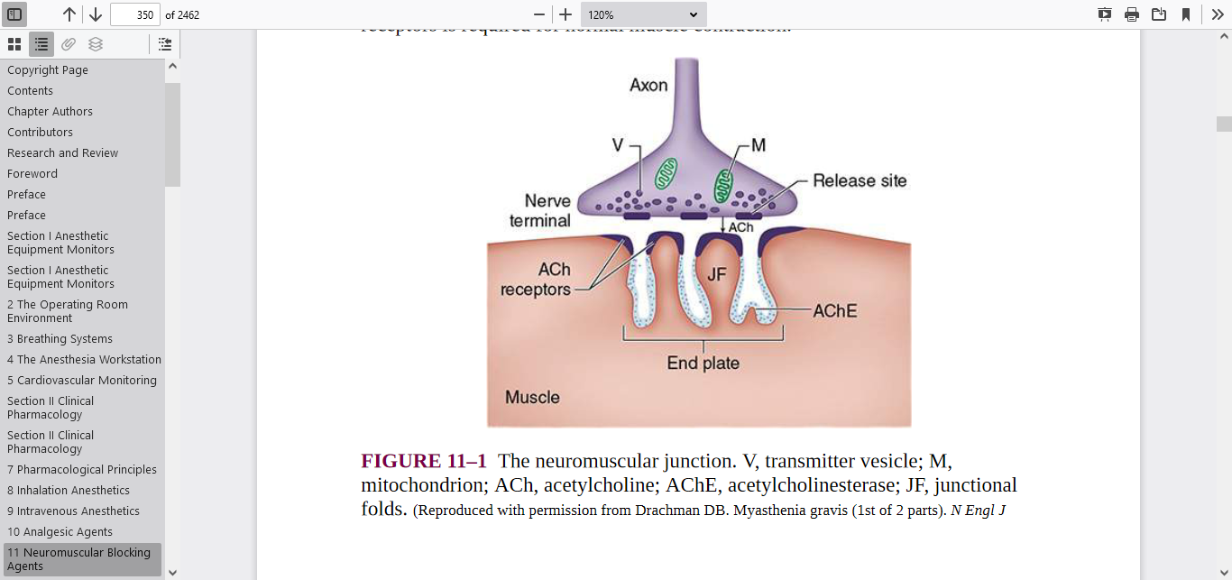

Slide 8
Each ACh receptor in the neuromuscular junction normally consists of five protein subunits: two α subunits, and single β, δ, and ε subunits. Only the two identical α subunits are capable of binding Ach molecules. If both binding sites are occupied by ACh, a conformational change in the subunits briefly (1 ms) opens an ion channel in the core of the receptor

Slide 9
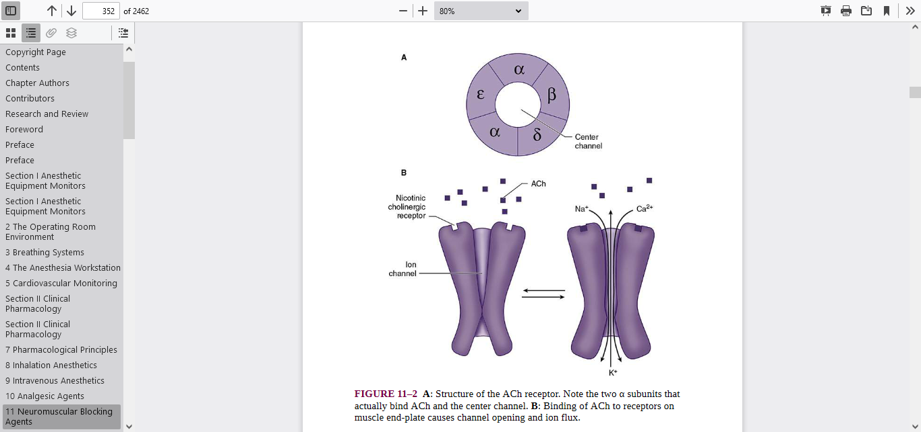

Slide 10
Cations flow through the open ACh receptor channel (Na and Ca in; K out), generating an end-plate potential. The number of quanta released by each depolarized nerve fiber, normally at least 200,it is very sensitive to extracellular ionized Ca concentration;↑ Ca concen.. increases the number of quanta released

Slide 11
When sufficient receptors are occupied by ACh, the end-plate potential will be strong enough to depolarize the perijunctional membrane. Voltage-gated sodium channels within this portion of the muscle membrane open when a threshold voltage is developed across them

Slide 12
The resulting action potential propagates along the muscle membrane and T-tubule system, opening sodium channels and releasing calcium from the sarcoplasmic reticulum.
This intracellular calcium allows the contractile proteins actin and myosin to interact, bringing about muscle contraction.

Slide 13
The amount of ACh released and the number of receptors subsequently activated with efferent nerve depolarization will normally far exceed the minimum required for the initiation of an action potential in the muscle.

Slide 14
Eaton–Lambert myasthenic syndrome is neuromuscular disease w/c is characterize by muscle weakness b/c of decreased release of Ach (↓signal) this occur when tenfold margin of safety is reduced
Myasthenia gravis is also neuromuscular disorder in w/c the skeletal muscle fail to contract b/c of decreased number of receptors.

Slide 15
ACh is rapidly hydrolyzed into acetate and choline by enzyme acetylcholinesterase (AchE) which is embedded into the motor end plate membrane. After unbinding ACh, the receptors’ ion channels close, permitting the end-plate to repolarize. Ca is resequestered in the sarcoplasmic reticulum, and the muscle cell relaxes

Slide 16
Acetylcholine is synthesized in the nerve terminal by the enzyme cholineacetyltransferase, which catalyzes the reaction between acetylcoenzyme A and choline.

Slide 17
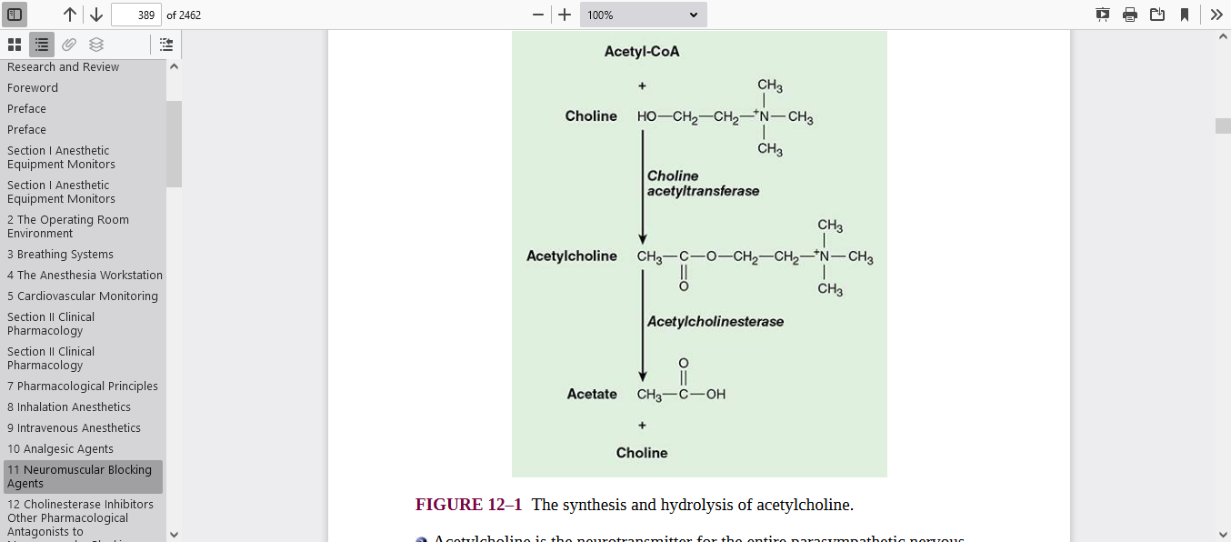

Slide 18
MECHANISM OF ACTION OF NMBD
Depolarizing MR very closely resemble ACh and readily bind to ACh receptors, generating a muscle action potential. Unlike ACh, however,these drugs are not metabolized by acetylcholinesterase, and their concentration in the synaptic cleft does‘t↓rapidly, resulting in prolonged depolarization of the muscle end-plate.

Slide 19
Continuous end-plate depolarization causes muscle relaxation because opening of perijunctional sodium channels is time limited (sodium channels rapidly “inactivate” with continuing depolarization;

Slide 20
After the initial excitation and opening.these sodium channels inactivate and cannot reopen until the end-plate repolarizes.
The end-plate cannot repolarize as long as the depolarizing muscle relaxant continues to bind to ACh receptors; this is called a phase I block.

Slide 21
More prolonged end-plate depolarization can cause poorly understood changes in the ACh receptor that result in a phase II block, which clinically resembles that of non depolarizing muscle relaxants.

Slide 22
Non depolarizing muscle relaxants bind ACh receptors but are incapable of inducing the conformational change necessary for ion channel opening. Because ACh is prevented from binding to its receptors, no end-plate potential develops.

Slide 23
depolarizing muscle relaxants act as ACh receptor agonists.
Whereas Non depolarizing muscle relaxants function as competitive antagonists.

Slide 24
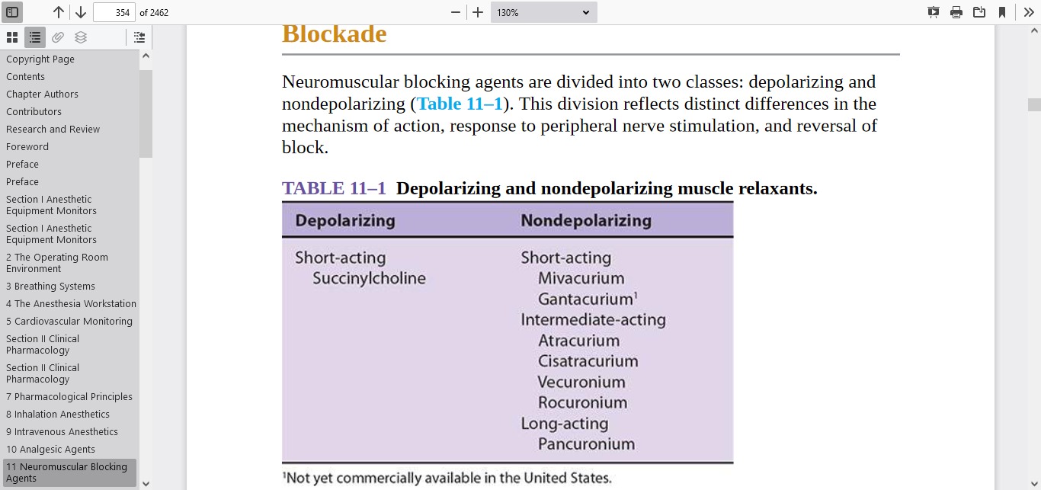
Distinctions Between Depolarizing and NDMB

Slide 25
Metabolism
AChE has an anionic and an esteratic binding site. The anionic site binds with the positively charged quaternary ammonium moiety while the esteratic site binds the ester group of ACh. At the point of ACh breakdown choline is released and AChE becomes acetylated. The acetylated enzyme is rapidly hydrolysed and acetic acid is produced.

Slide 26
Monitoring Neuromuscular Block
Muscle relaxants are monitored by examining the effect they have on muscle contraction following stimulation of the relevant nerve. Nerve stimulators must generate a supramaximal stimulus (60–80 mA) to ensure that all the composite nerve fibres are depolarised.

Slide 27
The duration of the stimulus is 0.1 milliseconds. The negative electrode should be directly over the nerve while the positive electrode should be placed where it cannot affect the muscle in question.
There are five main patterns of stimulation that are used and the characteristic responses observed in the relevant muscle reveal information about the block

Slide 28
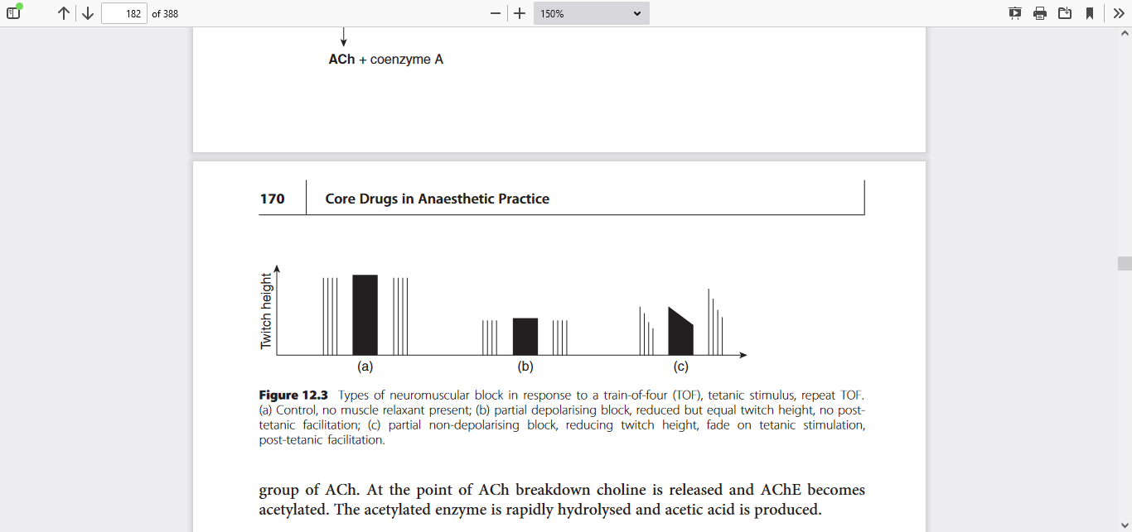

Slide 29
Sequence of onset of neuromuscular blockade
Eye and digits
Trunk &
abdomen
Intercostal muscle and diaphragm
The reverse is true while recovering

Slide 30
Cholinergic receptors subdivided into two major groups based on their reaction to the muscarine &nicotine . Nicotine stimulates the autonomic ganglia and skeletal muscle receptors (nicotinic receptors).

Slide 31
whereas muscarine activates end-organ effector cells in bronchia smooth muscle, salivary glands, and the sinoatrial node (muscarinic receptors).
Nicotinic receptors are blocked by muscle relaxants and muscarinic receptors are blocked by anticholinergic drugs.

Slide 32
Acetylcholine is the neurotransmitter for the entire parasympathetic nervous system (parasympathetic ganglions and effector cells), parts of the sympathetic nervous system (sympathetic ganglions, adrenal medulla, and sweat glands), some neurons in the central nervous system, and somatic nerves innervating skeletal muscle.

Slide 33
Neuromuscular transmission is blocked when non depolarizing muscle relaxants compete with acetylcholine to bind to nicotinic cholinergic receptors. The cholinesterase inhibitors indirectly increase the amount of acetylcholine available to compete with the nondepolarizing agent,thereby reestablishing neuromuscular transmission.

Slide 34
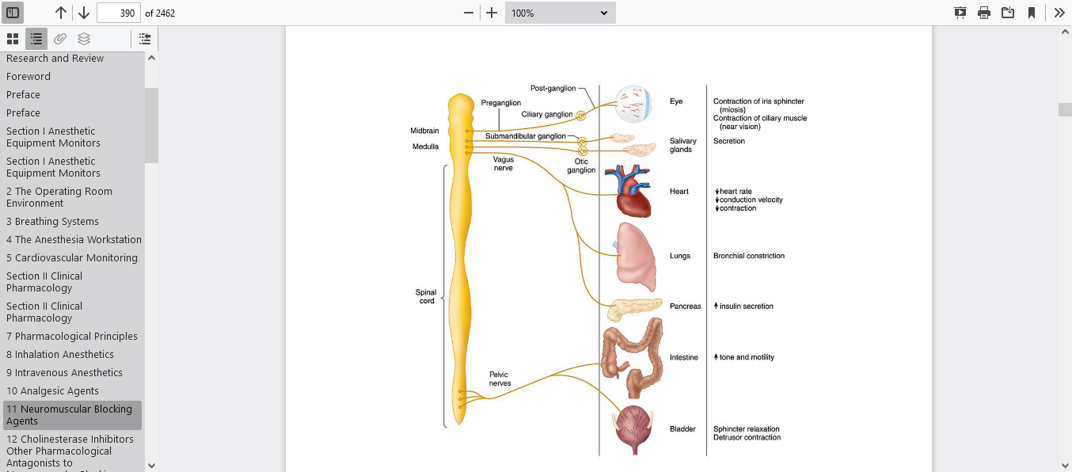
The parasympathetic nervous system uses acetylcholine as a
preganglionic and postganglionic neurotransmitter.

Slide 35
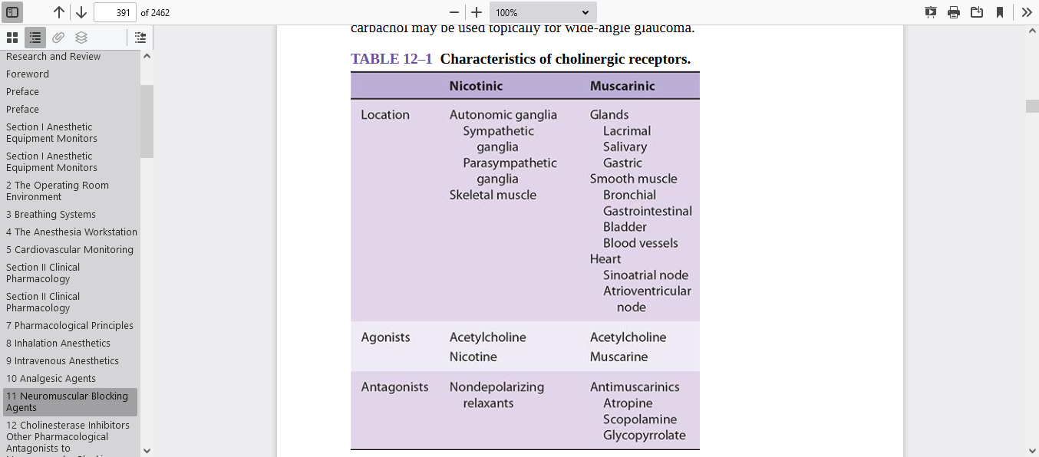

Slide 36
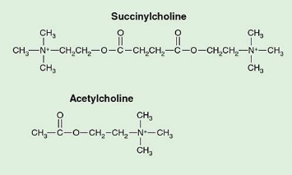
ΙΙ.Depolarizing muscle relaxant SUCCINYLCHOLINE/ suxamethonium
The only depolarizing muscle relaxant in clinical use.
suxamethonium consists of two joined Ach Molecule which are joined back-to-back through their acetyl groups

Slide 37
a colour less solution containing 50 mg/ml
Must be stored at 4°C. Dose 1-2mg/kg
used to achieve rapid muscle relaxation required during rapid sequence induction
mechanism of Action
Suxamethonium mimics the action of ACh by attaching to the nicotinic ACh receptor and causing membrane depolarisation.

Slide 38
However, because its hydrolysing enzyme (plasma or pseudo-cholinesterase) is not present at the NMJ its duration of action is longer than that of ACh. The persistent depolarisation produced initiates local current circuits that render the voltage-sensitive Na+ channels within 1–2 millimetres inactive prevents the transmission of further action potentials resulting in muscle relaxation

Slide 39
Metabolism & Excretion
Succinylcholine remains popular due to its rapid onset of action (30–60 s) and short duration of action <10 min). As succinylcholine enters the circulation,most of it is rapidly metabolized by plasma or pseudo cholinesterase into choline and succinylmonocholine.

Slide 40
only 20% of the initial intravenous dose reaches the NMJ, so that the rate of hydrolysis becomes a critical factor in determining the duration of the neuromuscular block.

Slide 41
Succinylmonocholine is metabolized further by plasma cholinesterase to succinic acid and choline. Because metabolism is rapid, less than 10% is excreted in the urine
As drug levels fall in blood, succinylcholine molecules diffuse away from the neuromuscular junction,limiting the duration of action.

Slide 42
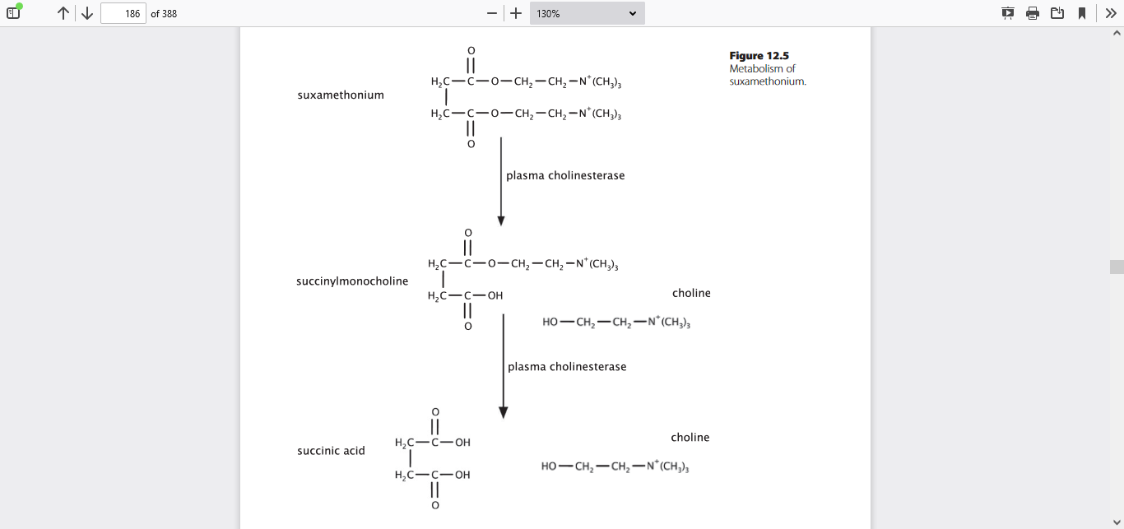

Slide 43
What will be the effect of decrease plasma pseudo cholinesterase ?

Slide 44
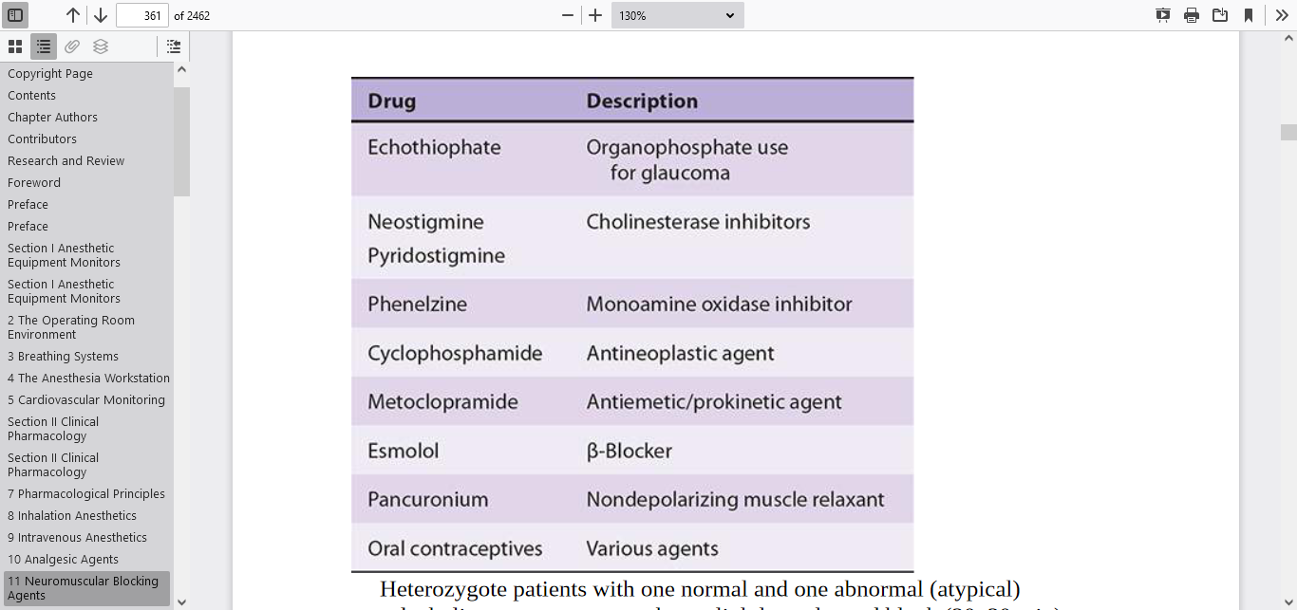
Drugs known to decrease pseudo cholinesterase activity.

Slide 45
Other Effects
1.Arrhythmias – bradycardia, and V.arrhythmia
2.Hyperkalaemia – a small rise in serum K+ is expected .
3.Myalgia – muscle pains are commonest in young females fasciculations is a brief spontaneous contraction affecting a small number of muscle fiber,often causeing a flicker of movement under the skin.

Slide 46
4. IOP – ↑ by about 10 mmHg for a matter of minutes and it is significant in the presence of global perforation.so C/I for open eye injury.

Slide 47
5.Intragastric pressure – rises by about 10 cmH2O, but as the lower oesophageal sphincter tone increases simultaneously there is no increased risk of reflux.
6. Anaphylaxis – suxamethonium is twice as likely to cause anaphylaxis compared to NDMRs,
7. Malignant hyperthermia
8.Prolonged neuromuscular block
9.Transite increase in ICP

Slide 48
Prolonged Block (Suxamethonium Apnoea)
Plasma cholinesterase activity may be reduced due to genetic variability or acquired conditions, leading to prolonged neuromuscular block.
Single amino acid substitutions are responsible for genetically altered enzymatic activity.96% of the population is homozygous for the normal Eu gene and metabolise suxamethonium rapidly

Slide 49
Up to 4% may be heterozygotes resulting in a mildly prolonged block of up to 10 minutes, while a very small fraction may have a genotype that confers a block of a few hours. This prolonged block may be reversed by administration of fresh frozen plasma,

Slide 50
Dibucaine (cinchocaine) is an amide local anaesthetic that inhibits normal plasma cholinesterase. However, it inhibits the variant forms of plasma cholinesterase less effectively

Slide 51
Dibucaine inhibits the Eu:Eu form by 80% but the Ea:Ea form by only 20%. Other combinations are inhibited by 20–80% depending on the type involved. The percentage inhibition is known as
the ‘Dibucaine number’ and indicates the genetic makeup for an individual
As example Dibucaine number 80 is normal enzyme deficiencies, patient with homozygous atypical pseudocholinesterase)

Slide 52
Acquired factors associated with reduced plasma cholinesterase activity include:
• Pregnancy
• Liver disease
Renal failure
• Cardiac failure
• Thyrotoxicosis
• Cancer
• Drugs – inhibitor to AChE.

Slide 53
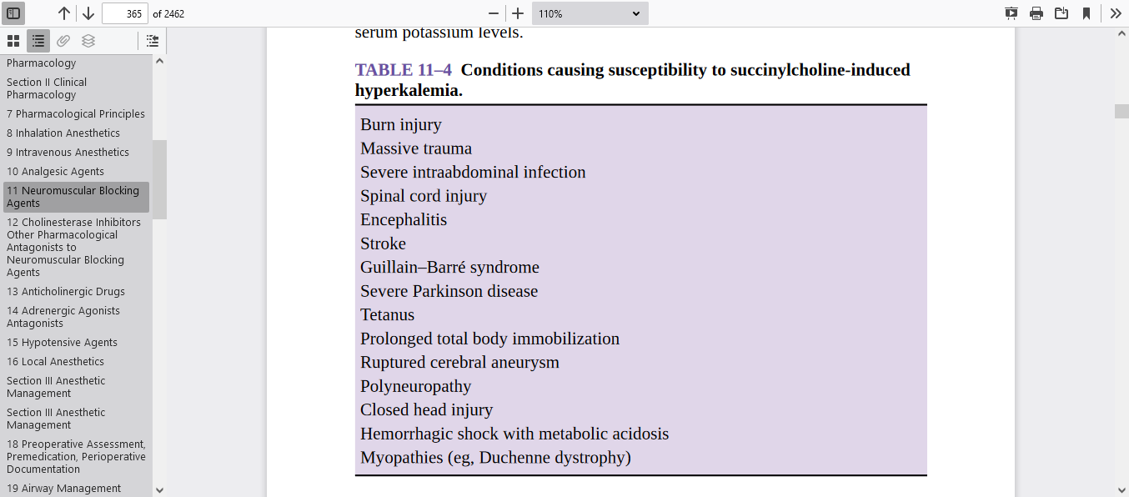

Slide 54
Non-Depolarising Muscle Relaxants(NDMR)
It inhibit the actions of ACh at the NMJ by binding competitively to the α subunit of the nicotinic ACh receptor on the post-junctional membrane, more than 70% of receptors need to be occupied by muscle relaxant before neuromuscular blockade can be detected by a peripheral nerve stimulator
The non-depolarising block has essentially the same characteristics as the Phase II block

Slide 55
NDMRs fall in one of 2 chemical groupings:
• Aminosteroidal compounds vecuronium, rocuronium, pancuronium
• Benzylisoquinolinium compounds – atracurium, mivacurium, tubocurarine
Also can be divided according to their duration of action: • Short – mivacurium
• Intermediate – atracurium
• Long – pancuronium.
Notes:
Steroidal compounds can be vagolytic, most notably with pancuronium but
Benzylisoquinolines tend to release histamine.
Histamine release from mast cells can result in bronchospasm, skin flushing, and hypotension from peripheral vasodilation

Slide 56
NDMR are relatively polar in nature, non-depolarising drugs are unable to cross lipid membranes, resulting in a small volume of distribution. Some are hydrolysed in the plasma while others undergo a degree of hepatic metabolism, The unmetabolized fraction is excreted in the urine or bile.

Slide 57
Vecuronium
It is usually called ‘clean’ drug.
Its chemical structure differs from pancuronium by a single methyl group, making it the monoquaternary analogue.
Presentation and Uses
Vecuronium is potentially unstable in solution and so is presented as 10 mg freeze-dried

Slide 58
powder containing mannitol and sodium hydroxide and is dissolved in 5 ml water before administration.
At 0.1 mg/kg− satisfactory intubating conditions are reached in about
90–120 seconds. It has a medium duration of action

Slide 59
A 42 years old lady with CBD obstruction is in OR table for exploration . her weight is 65kg ,the anesthesia team dilute powder vecroniem with 10ml distilled water and want to do ETTI with vecroniem how many mg and ml is required?

Slide 60
vecuronium is metabolised in the liver by de-acetylation to 3- and 17-hydroxy and 3,17-dihydroxy-vecuronium. Again the 3-hydroxy metabolite carries significant muscle-relaxant properties but little clinical significance with normal renal function it is more lipid-soluble than pancuronium and, despite the metabolism of a similar proportion in the liver, a far greater proportion is excreted in the bile. It may accumulate during administration by infusion

Slide 61
Rocuronium
It was developed from vecuronium
rapid onset with intubating conditions 60–90S. Its effects are reversed not only by anticholinesterases but also by sugammadex
A MR with a low potency must be given at a higher dose to achieve a clinically significant effect. A higher number of molecules result in a greater concentration gradient from the plasma to the NMJ so that diffusion is faster and onset time is reduced.

Slide 62
Presentation and Uses
Rocuronium is prepared as a colourless solution containing 50 mg in 5 ml.
At 0.6 mg/kg intubating conditions are reached within 100–120 seconds,
higher doses (0.9–1.2 mg.kg−1). 60 S.
Its duration of action is similar to that of vecuronium but higher doses ↑ significantly.
Cardiovascular – minimal cardiovascular effects, at high doses may ↑ HR
.

Slide 63
Metabolisem
Rocuronium is mainly excreted unchanged in the bile and to a lesser extent in the urine,although some de-acetylated metabolites may be produced. Its duration of action may be prolonged in hepatic and renal failure

Slide 64
Pancuronium
Pancuronium is a bisquaternary aminosteroidal compound.
a colourless solution containing 4 mg in 2 ml stored at 4°C.
At 0.1 mg/kg intubating conditions after 90–150 seconds.
Its duration of action is about 45 minutes.

Slide 65
Other Effects
• Cardiovascular –↑ HR blocking cardiac muscarinic receptors. have indirect sympathomimetic actions by preventing the uptake of noradrenaline at post-ganglionic nerve endings. pancuronium blocks vagal muscarinic receptors in the sinoatrial node, resulting in tachycardia and ↑BP
Some arrythmia may occur

Slide 66
10% and 40% is plasma protein-bound
has a low volume of distribution.
35% is metabolised in the liver by de-acetylation to 3- and 17-hydroxy and 3,17-dihydroxy-pancuronium, the former of which is half as potent as pancuronium. Unchanged drug is eliminated mainly in the urine.
metabolites are excreted in bile

Slide 67
Atracurium
It is a benzylisoquinolinium compound.
Presentation and Uses
colourless solution containing 10 mg/ml/ in 2.5/ 5 /25ml vials. stored at 4°C. At 0.5 mg/kg intubating conditions are reached within 90–120 seconds.

Slide 68
• rapid administration it may precipitate the release of histamine, which may be localised to the site of injection but may be generalised resulting in bronchospasm and hypotension. Slow intravenous injection minimizes these effects.
• Myopathy – in a manner similar to that of vecuronium, atracurium is associated with critical illness myopathy

Slide 69
Metabolisem
less than 10% is excreted unchanged by renal and biliary routes.
undergoing ester hydrolysis and Hofmann elimination.
• Ester hydrolysis – non-specific esterases hydrolysis about 60% of it The breakdown products are a quaternary alcohol, a quaternary acid and laudanosine. acidic conditions accelerate this metabolic pathway.hydrolysis of atracurium.

Slide 70
Hofmann elimination – while atracurium is stable at pH 4 and at 4°C, Hofmann elimination describes its spontaneous breakdown to laudanosine and aquaternary monoacrylate when placed at normal body temperature and pH.

Slide 71
Laudanosine Toxicity,a tertiary amine, is a breakdown product of atracurium’s Hofmann elimination and has been associated with CNS excitation,resulting in elevation of the MAC and even precipitation of seizures.

Slide 72
Acidosis and hypothermia slow the process.
breakdown products may have potentially serious side effects like seizure. Laudanosine, being a glycine antagonist, has no neuromuscular-blocking properties and is cleared by the kidneys.
These metabolic pathways are independent of hepatic or renal function,

Slide 73
Cisatracurium
Cisatracurium is one of the 10 stereoisomers present in atracurium. Presentation and Use presented as a colourless solution containing 2 or 5 mg/ml and should be stored at 4°C. It is 3 to 4X more potent than atracurium and, therefore, has a slower onset time. onset time can be improved by ↑ the dose it extremely low histamine releas

Slide 74
The predominant pathway for its elimination is Hofmann elimination to laudanosine and a monoquaternary acrylate. This is then hydrolysed by non-specific plasma esterases to a monoquaternary alcohol and acrylic acid.no NMB property. Safe for children from 2 years of age and in elderly patients. can be used in end-stage renal or hepatic impairment

Slide 75
Mivacurium
Mivacurium (a benzylisoquinolinium ester – similar to atracurium) is a chiral mixture of three stereospecific isomers in the following proportions:
• 36% cis-trans
• 58% trans-trans
• 6% cis-cis.

Slide 76
Mivacurium, like succinylcholine, is metabolized by pseudocholinesterase.
However, like other nondepolarizing agents, cholinesterase inhibitors will antagonize mivacurium-induced neuromuscular blockade.
Edrophonium more effectively reverses mivacurium blockade than neostigmine because neostigmine inhibits plasma cholinesterase activity.

Slide 77
The main advantage of mivacurium is its short duration of action. Routine reversal of mivacurium with neostigmine may not be required due to its rapid enzymatic metabolism.

Slide 78
Presentation and Uses
Mivacurium is presented as an acidic (pH 3.5–5.0) aqueous solution containing 2 mg/ml in 5 and 10 ml ampoules. It has a shelf-life of 18 months when stored below 25°C.
Effects
• Cardiorespiratory – high doses may release histamine, resulting in a fall in blood pressure and bronchospasm.

Slide 79
Plasma cholinesterase is responsible for the metabolism of the cis-trans and trans-trans isomers, so those patients with genetically low plasma cholinesterase level are subject to prolonged neuromuscular blockade. Its duration of action is significantly prolonged in patients with end-stage liver disease, mainly due to reduced plasma cholinesterase activity

Slide 80
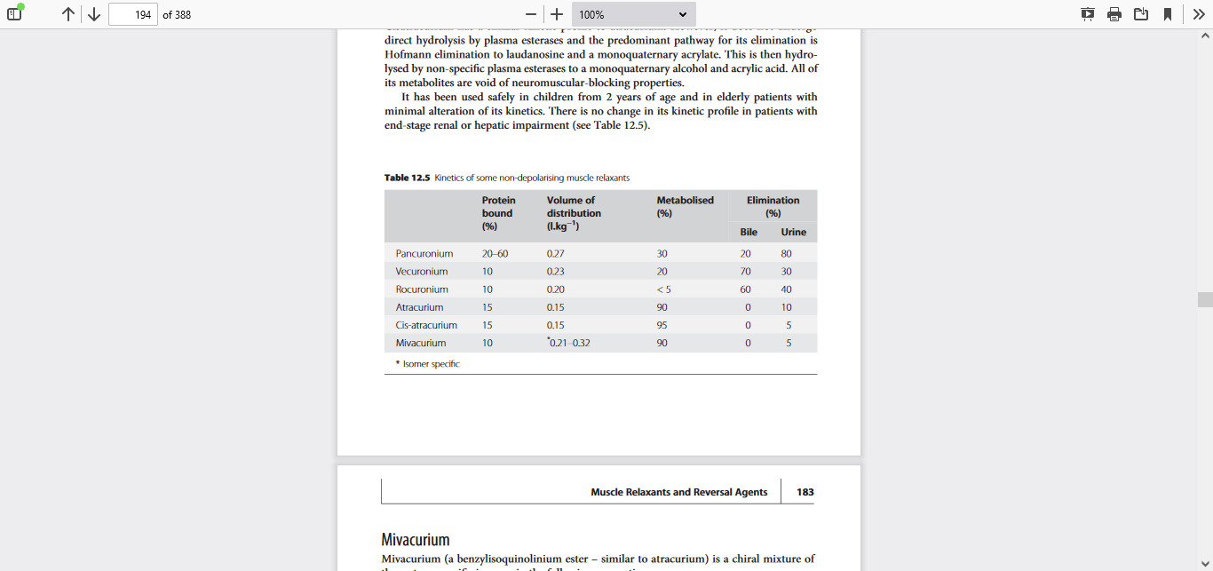

Slide 81
NEWER MUSCLE RELAXANTS
Gantacurium belongs to a new class of nondepolarizing neuromuscular blockers called chlorofumarates. In preclinical trials, gantacurium demonstrated an ultrashort duration of action, similar to that of succinylcholine. Its pharmacokinetic profile is explained by the fact that it undergoes non enzymatic degradation.

Slide 82
inhalational anesthetic potentiate muscle relaxant as follow (desflurane > sevoflurane > isoflurane > halothane > N2O/narcotic>TIVA.
Only pancuronium, vecuronium, and rocuronium are metabolized to varying degrees by the liver.
Vecuronium and rocuronium depend heavily on biliary excretion. Clinically,liver failure prolongs blockade. Severe liver disease does not significantly affect clearance of atracurium or cisatracurium, but the associated decrease in pseudocholinesterase levels may slow the metabolism of mivacurium.

Slide 83
variables affect all non depolarizing MR
A.Temperature:Hypothermia prolongs blockade by decreasing metabolism (eg, mivacurium,atracurium&cisatracurium) and delaying excretion (eg, pancuronium and vecuronium).

Slide 84
B. Acid–Base Balance
Respiratory acidosis potentiates the blockade of most nondepolarizing relaxants and antagonizes its reversal. This could prevent complete neuromuscular recovery in a hypoventilating postoperative patient.
Electrolyte Abnormalities Hypokalemia and hypocalcemia augment a nondepolarizing block.

Slide 85
magnesium sulfate in the operating room potentiates a nondepolarizing blockade by competing with ca at the motor end-plate.
D. Age
Neonates have an increased sensitivity to non depolarizing relaxants because of their immature neuromuscular junctions

Slide 86
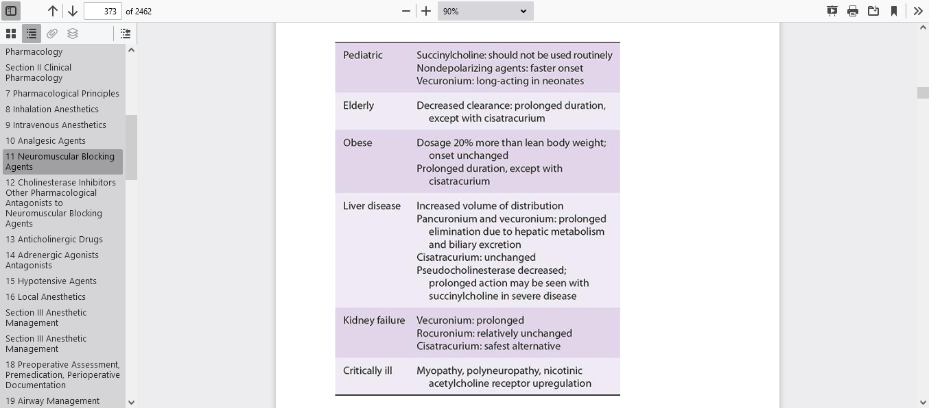

Slide 87
Intraoperative hyperventilation is a common cause of postoperative apnea. Because volatile agents and opioids raise the apneic threshold, the PaCO2 level at which spontaneous ventilation ceases, moderate postoperative hypoventilation may be required to stimulate the respiratory centers.

Slide 88
Pupil size is not always a reliable indicator of central nervous system integrity. Fixed and dilated pupils in the absence of anticholinergic medication or ganglionic blockade, however, may be an ominous sign. Response to physical stimulation, such as a forceful jaw thrust, may differentiate somnolence from paralysis. Peripheral nerve stimulation also differentiates paralysis from coma.

Slide 89
At a time of delayed reversal Supportive mechanical ventilation should be continued in the unresponsive patient. Naloxone, flumazenil, and physostigmine may be indicated, depending on the probable cause of the delayed emergence, if drug effects are suspected and reversal is considered both safe and desirable.

Slide 90
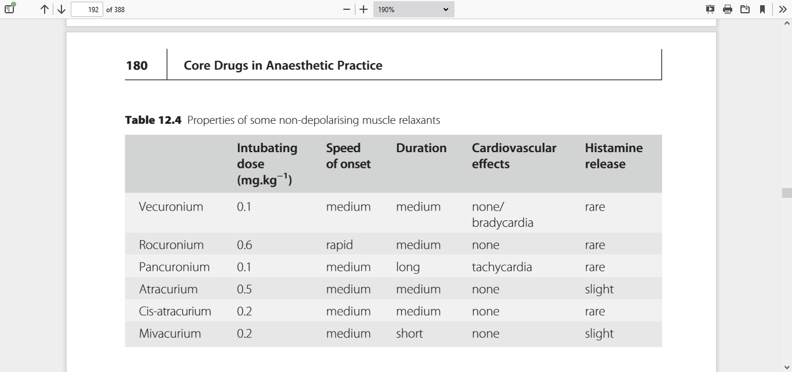

Slide 91
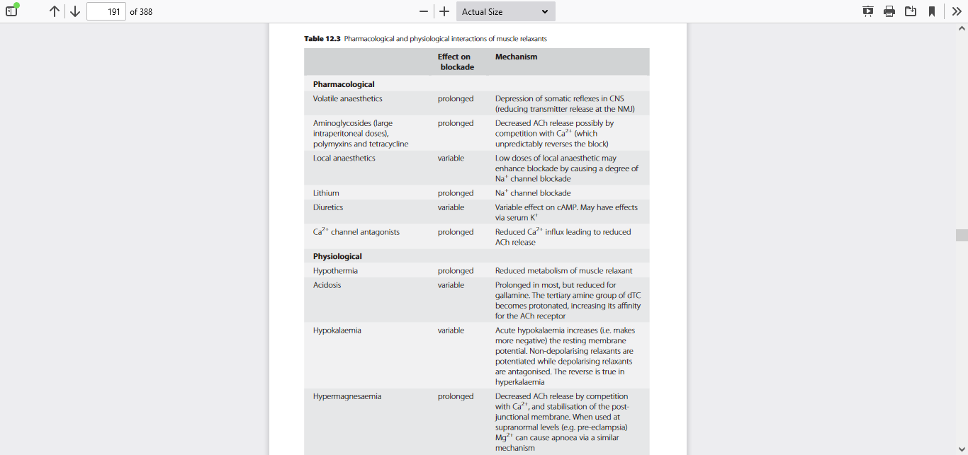

Slide 92
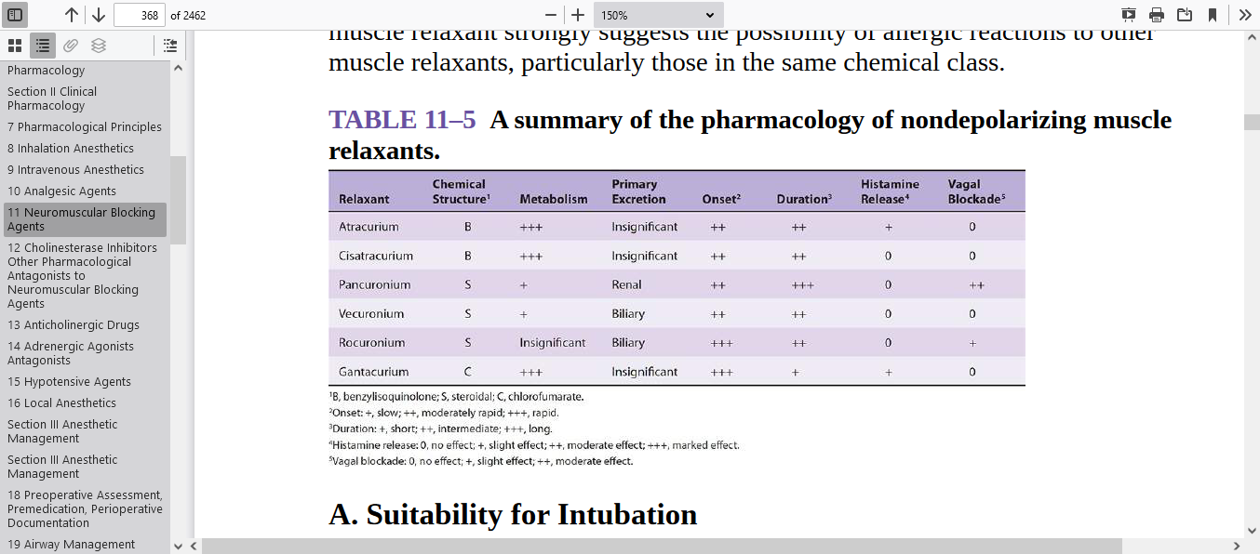

Slide 93
ΙΙΙ.Anticholinesterases or Reversal Agents

Slide 94
Physiology Normal neuromuscular transmission depends on ACh binding to nicotinic cholinergic receptors on the motor end-plate. Non depolarizing musclerelaxants(NDMR) act by competing with Ach for these binding sites, there by blocking neuromuscular transmission. Reversal of blockade depends on diffusion, redistribution, metabolism, and excretion.

Slide 95
Anticholinesterases The enzyme AChE is responsible for the hydrolysis of ACh. Anticholinesterases antagonise AChE, slowing down this reaction, so that more ACh is available at the NMJ.
As AChE is present at sites other than the NMJ, anticholinesterases have effects other than reversal of NDMRs. For this reason an anticholinergic agent is often given with an anticholinesterase. When reversing NDMR, the goal is to maximize nicotinic transmission with a minimum of muscarinic side effects.

Slide 96
Cholinesterase inhibitors inactivate acetylcholinesterase by reversibly binding to the enzyme. The stability of the bond influences the duration of action. The electrostatic attraction and hydrogen bonding of edrophonium are short-lived; the covalent bonds of neostigmine and pyridostigmine are longer lasting.

Slide 97
Organophosphates, a special class of cholinesterase inhibitors that have been used in ophthalmology ecothiopate iodide has been used to treat glaucoma by improving drainage channels of the trabecular meshwork. These agents are highly lipid-soluble so rapidly absorbed and form stable, irreversible bonds to the enzyme for a long-lasting effect.

Slide 98
Chemical warfare nerve agents (eg, sarin) are also organophosphat. Death occurs secondary to overstimulation of both nicotinic and muscarinic receptors. Cholinesterase inhibitors are also used in the diagnosis and treatment of MG. what is cholinergic crises?

Slide 99
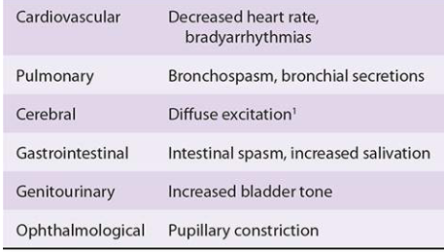
Muscarinic side effects of cholinesterase inhibitors

Slide 100
When pt. Reversed
The absence of any palpable single twitches following 5 s of tetanic stimulation at 50 Hz implies a very intensive blockade that cannot be reversed by cholinesterase inhibitors. Absent of effort for spontaneous respiration is also contraindication b/c of risk of recurrization.

Slide 101
A peripheral nerve stimulator should also be used to monitor the progress and confirm the adequacy of reversal (≥2 twitches needs on TOF ). Clinical signs of adequate reversal vary in sensitivity (sustained head lift > inspiratory force > VC > TV).

Slide 102
The differing mechanism of action of anticholinesterases allows 3 groups to emerge • Easily reversible inhibition • Formation of a carbamylated enzyme complex • Irreversible inactivation

Slide 103
Easily Reversible Inhibition
Edrophonium is a phenolic quaternary amine. has rapid onset (1/2 min) and the shortest duration. Reduced doses should not be used, because longer-acting muscle relaxants may outlast the effects of edrophonium.
Uses at an intravenous dose of 2–10 mg it rapidly distinguishes between a myasthenic crisis (where muscle power is improved) and a cholinergic crisis (where the clinical picture is worsened).

Slide 104
Mechanism of Action The quaternary amine group of edrophonium is attracted to the anionic site of AChE while its hydroxyl group forms a hydrogen bond at the esteratic site and stabilises the complex. ACh is now unable to reach the active site of AChE. However, ACh competes with edrophonium for AChE because a true covalent bond is not formed between edrophonium and AChE. Edrophonium also causes increas ACh release.

Slide 105
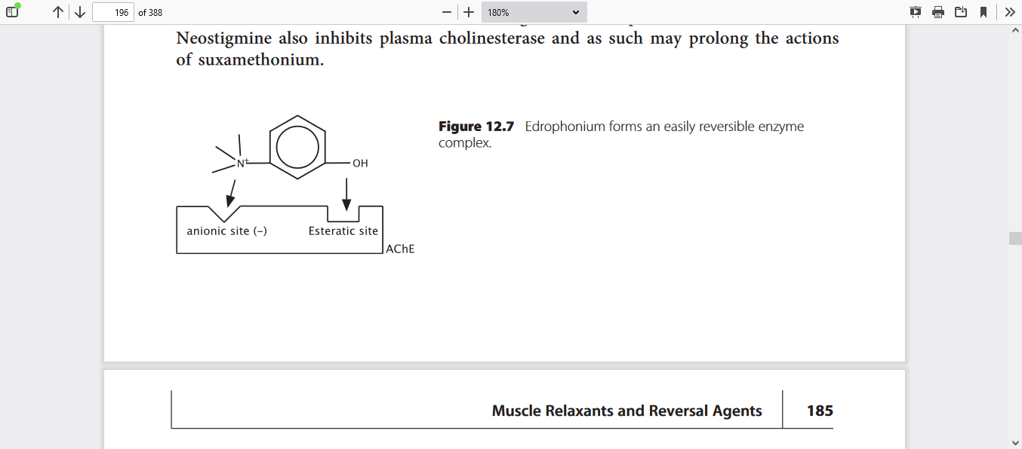

Slide 106
Higher doses prolong the duration of action to more than 1 h. Edrophonium may not be effective in reversing intense neuromuscular blockade. It is given with glycopyrrolate , several minutes prior to edrophonium to avoid the possibility of bradycardia.

Slide 107
has a low lipid solubility.it does not cross the BBB . It has a faster onset of action than neostigmine. Up to 65% is excreted unchanged in the urine the rest undergoes glucuronidation in the liver and excretion in the bile. It has only slight muscarinic side effects but may still cause a ↓HR &salivation.

Slide 108
Formation of Carbamylated Enzyme Complex
Neostigmine, pyridostigmine, physostigmine Mechanism of Action Both ACh and the carbamate esters are hydrolysed when they react with AChE.However, ACh acetylates AChE while the carbamate esters produce a carbamylated enzyme. The later has a much slower rate of hydrolysis and so is unable to work for longer, hence, it stops AChE hydrolysing ACh. The carbamate esters are also known as time-dependent AChE inhibitors.

Slide 109
Neostigmine Neostigmine is a quaternary amine. Neostigmine is available as tablets/solution for IV. For reverse (0.05 mg/kg IV ), in the treatment of myasthenia gravis (15–30 mg orally where effects last up to 4 hours) and in urinary retention. Effects CVS –↓HR, It has a limited role SVT. Respiratory – it may precipitate bronchospasm. Gut – it increases salivation and intestinal motility, result in abdominal cramps

Slide 110
Neostigmine is poorly absorbed from the gut and has a low oral bioavailability. It is partially metabolised in the liver. Approximately 55% is excreted unchanged in the urine. Neostigmine is also used to treat myasthenia gravis, urinary bladder atony,&paralytic ileus. Neostigmine also inhibits plasmcholinesterase.

Slide 111
WHAT WILL BE THE EFFECT OF NEOSTEGMINE IN REVERSING DEPOLARIZING MR?
WHAT DO YOU THINK THE ADVERSE EFFECT OF NEOSTEGMIN?

Slide 112
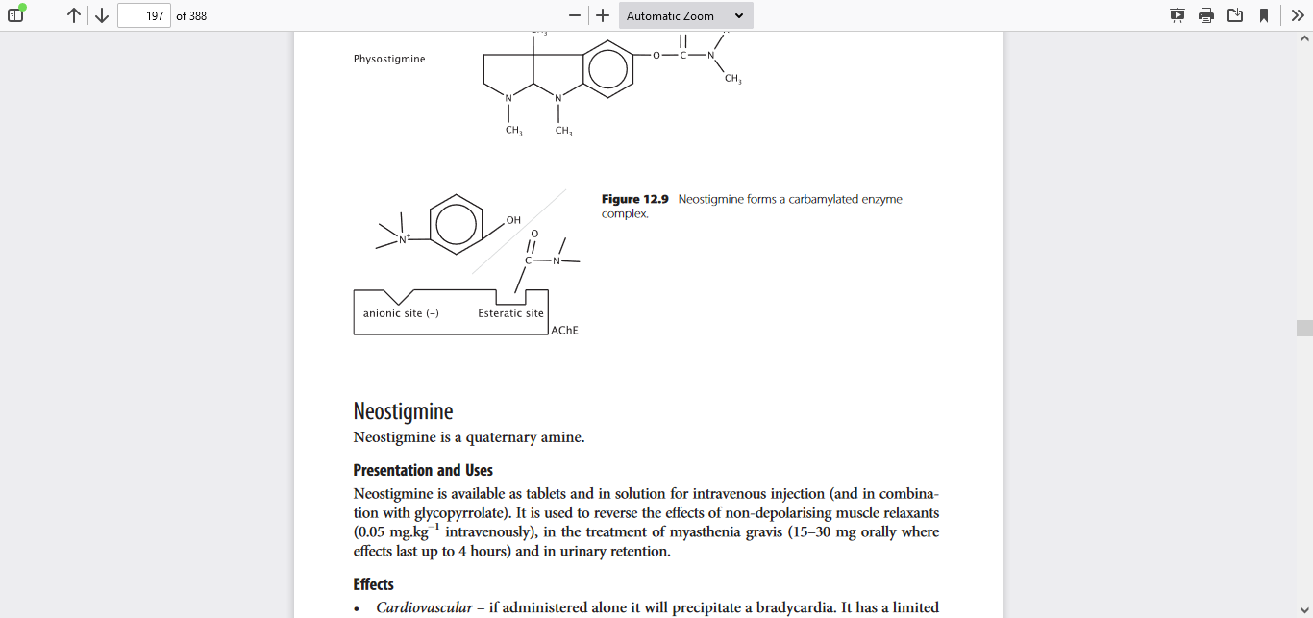
Neostigmine forms a carbamylated enzyme complex

Slide 113
Pyridostigmine Pyridostigmine is also a quaternary amine used mainly in the treatment of myasthenia gravis, has a slower onset of action but longer duration of action then neostigmine and fewer autonomic effects. Kinetics It relies on renal elimination more (75% excreted unchanged) does not cross BBB.

Slide 114
PHYSOSTIGMINE
Physostigmine, a tertiary amine, has a carbamate group but no quaternar ammonium. Therefore, it is lipid soluble and is the only clinically available cholinesterase inhibitor that freely passes the BBB
The lipid solubility and CNS penetration of physostigmine limit its usefulness as a reversal agent for nondepolarizing blockade, it is used in the treatment of anticholinergic poisoning it reverses some of the CNS depression and delirium associated with use of benzodiazepines and volatile anesthetics.

Slide 115
Physostigmine (0.04 mg/kg) has been shown to be effective in preventing postoperative shivering. It reportedly partially antagonizes morphine- induced respiratory depression. Bradycardia is infrequent in the recommended dosage range,but atropine should be immediately available not glycopyrrolate.
In contrast to other cholinesterase inhibitors, physostigmine is almost completely metabolized by plasma esterases, so renal excretion is not important.

Slide 116
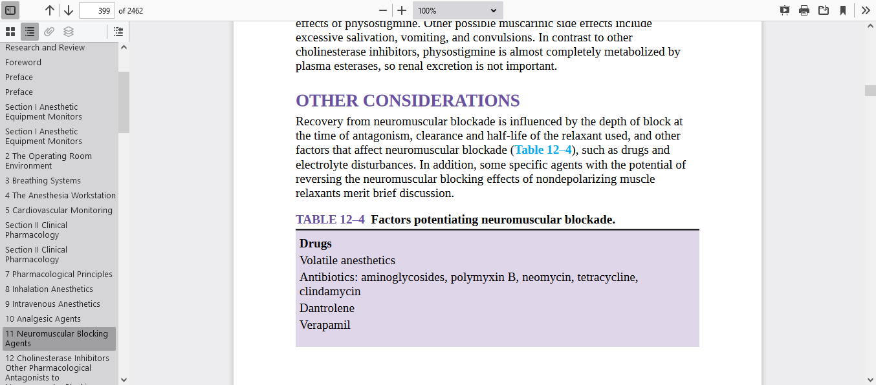
factors that affect neuromuscular blockade such as drugs and electrolyte disturbances

Slide 117
Sugammadex
Sugammadex is a γ cyclodextrin and is sometimes referred to as a selective relaxant binding agent (SRBA).. Uses and Mechanism of Action indication is the reversal of neuromuscular blockade induced by rocuronium or vecuronium. It selectively encapsulates these aminosteroidal NDMRs and effectively removes them from the plasma and the NMJ.

Slide 118
No side effects like other anticholinesterases. Presentation and Dose It is presented as a 100 mg/ml solution in 2/5 ml
Routine Reversal Dose is 4 mg/kg. Emergency Reversal Dose (immediately following 1.2 mg/kg rocuronium) is 16 mg/kg.

Slide 119
Interactions The most significant is the potential reduction in efficacy of oral contraceptives. This should be discussed with those concerned and they should be advised to use additional contraception following administration of sugammadex

Slide 120
It is excreted solely via the kidneys with an effective half-life of 2.5 hours. Side Effects Hypersensitivity reactions remain the main concern & bradycardia very rarely
newer agents, such as cyclodextrins and cysteine, with superior ability to reverse neuromuscular blockade from specific agents, are being employed or investigated.

Slide 121
ΙV.Anticholinergics
Drugs that block muscarinic receptors.effective antagonists at muscarinic receptors(antimuscarinic )very little activity at nicotinic receptor classification naturally occurring tertiary amines, atropine and hyoscine, are esters formed by the combination of tropic acid and an organic base (tropine or scopine) cross the BBB So have central effects include sedation, amnesia, antiemesis and the central anticholinergic syndrome. Glycopyrrolate is a synthetic quaternary amine with no central effects as it is unable to cross the BBB

Slide 122
MECHANISMS OF ACTION
Anticholinergics are esters of an aromatic acid combined with an organic base. The ester linkage is essential for effective binding of the anticholinergics to the acetylcholine receptors. This competitively blocks binding by acetylcholine and prevents receptor activation.

Slide 123
The cellular effects of acetylcholine, which are mediated through second messengers, are inhibited. The tissue receptors vary in their sensitivity to blockade. In fact,muscarinic receptors are not homogeneous, and receptor subgroups have been identified, including CNS (M1,4,5), autonomic ganglia and gastric parietal cells (M1), cardiac (M2), and smooth muscle (M3) receptors.

Slide 124
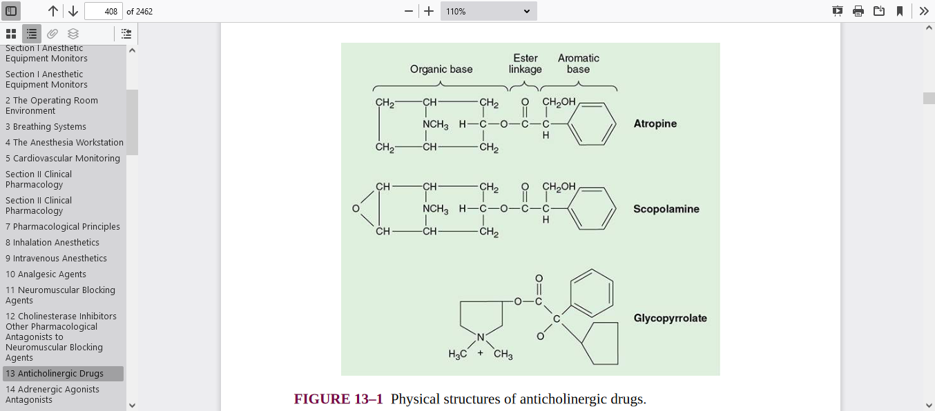

Slide 125
hyoscine’s(scopolamine)
main uses are derived from its central antimuscarinic effects, it also has peripheral antimuscarinic effects some of which can be useful
central effects –Transdermal administration is effective in reducing PONV and motion sickness despite very low plasma levels.

Slide 126
It is extensively metabolised by liver esterases and only a small fraction is excreted unchanged in the urine. Its duration of action is shorter than atropine
scopolamine is a more potent antisialagogue than atropine and causes greater central nervous system effects. it may precipitate a central anticholinergic syndrome.

Slide 127
Atropine
used to treat bradycardia and as antisialogogue. antagonise the muscarinic side effects of anticholinesterases. CNS less likely to cause a central cholinergic crisis than hyoscine so less sedative. CVS – it may cause an initial bradycardia following a small intravenous dose. may be due to partial agonist effect at cardiac muscarinic receptors.

Slide 128
Respiratory system – bronchodilation is more marked than with hyoscine.Bronchial secretions are reduced. Anticholinergics relax the bronchial smooth musculature, which reduces airway resistance

Slide 129
Gut – it is a less effective anti-sialogogue than hyoscine. The tone of the lower oesophageal sphincter is ↓ and there is a small decrease in gastric acid secretion. • Miscellaneous – sweating is inhibited and this may provoke a pyrexia in paediatric patients.

Slide 130
When administered topically it may increase intra-ocular pressure, which may be critical for patients with glaucoma It is 50% plasma protein-bound and extensively metabolised by liver esterases.It is excreted in the urine, only a tiny fraction unchanged.

Slide 131
Atropine has particularly potent effects on the heart and bronchial smooth muscle and is the most efficacious anticholinergic for treating bradyarrhythmias Ipratropium solution (0.5 mg in 2.5 mL) seems to be particularly effective in the treatment of acute chronic obstructive pulmonary disease when combined with a β-agonist drug (eg, albuterol).

Slide 132
Glycopyrrolate
indicated for anti-sialogogue premedication, for treatment of bradycardia and to protect against the unwanted effects of anticholinesterases. Its charged quaternary structure gives it different from tertiary amines. It does not cross the BBB and so no central effects. It is minimally metabolised and 80% is excreted in the urine unchanged.

Slide 133
